Slide 1

HOW TO SET-UP A PAYMENT PLAN
Cashier’s Office

Slide 2
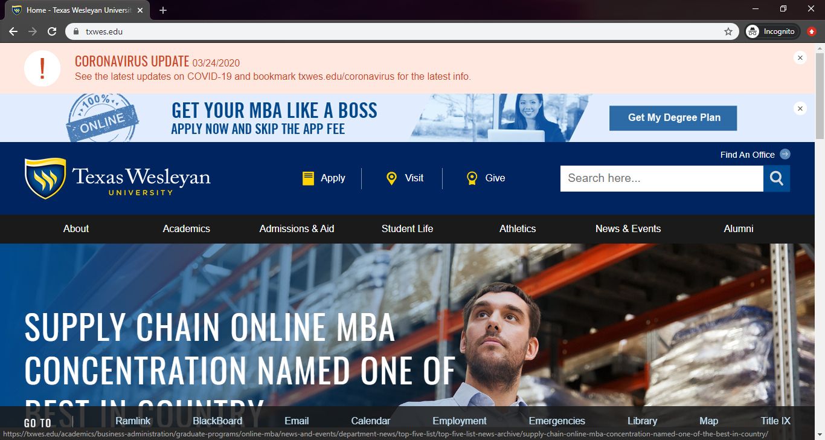
Go to www.txwes.edu
Click on Ramlink

Slide 3
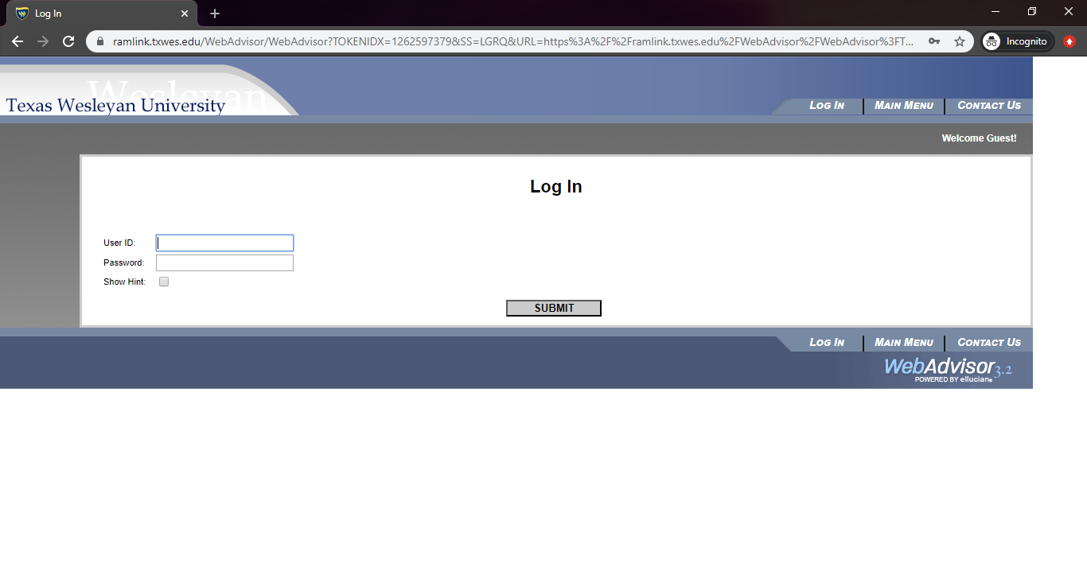
Log-in using login credentials

Slide 4
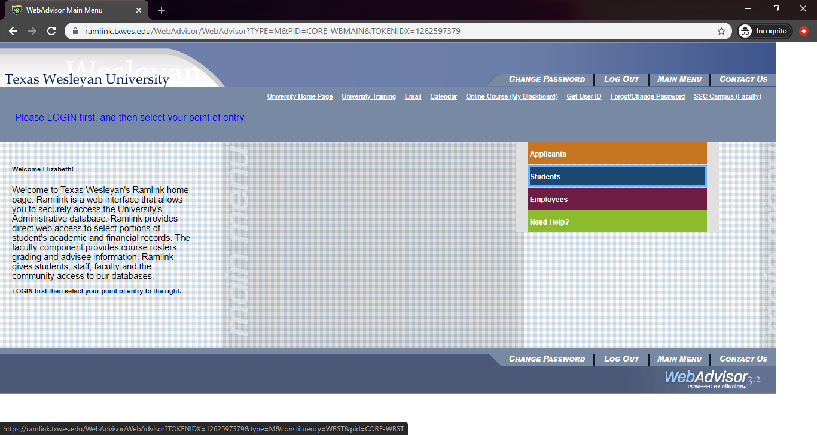
Click on the Student’s Tab

Slide 5
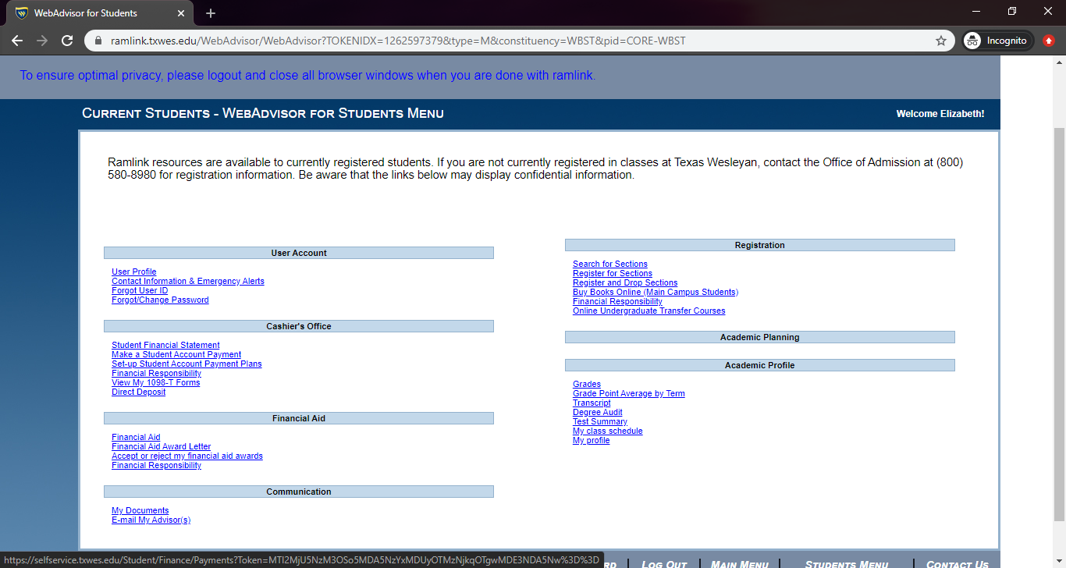
Click on “Set-up Student Account Payment Plans”

Slide 6
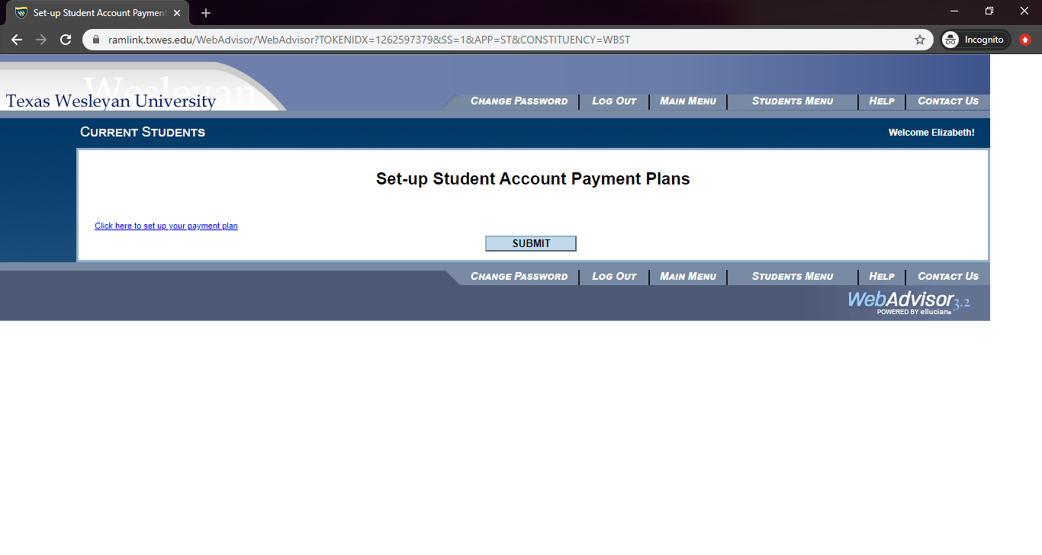
Click on where it says “Click here…”

Slide 7
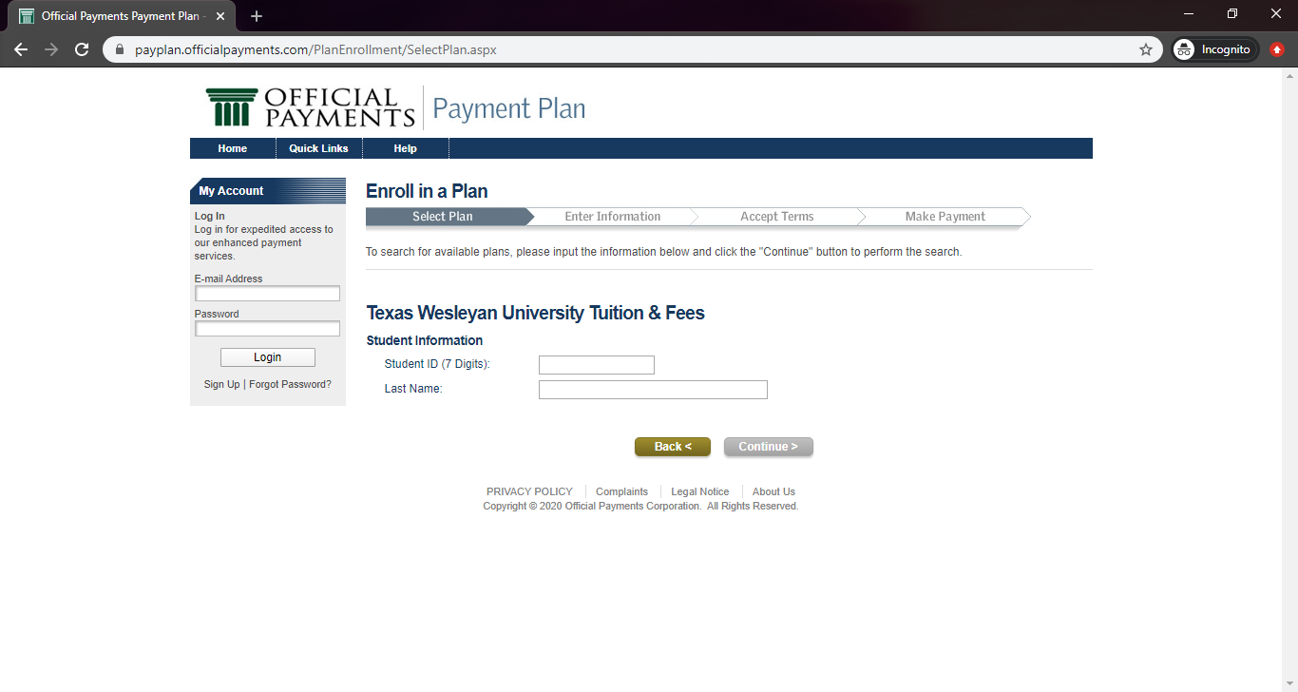
Enter credentials

Slide 8
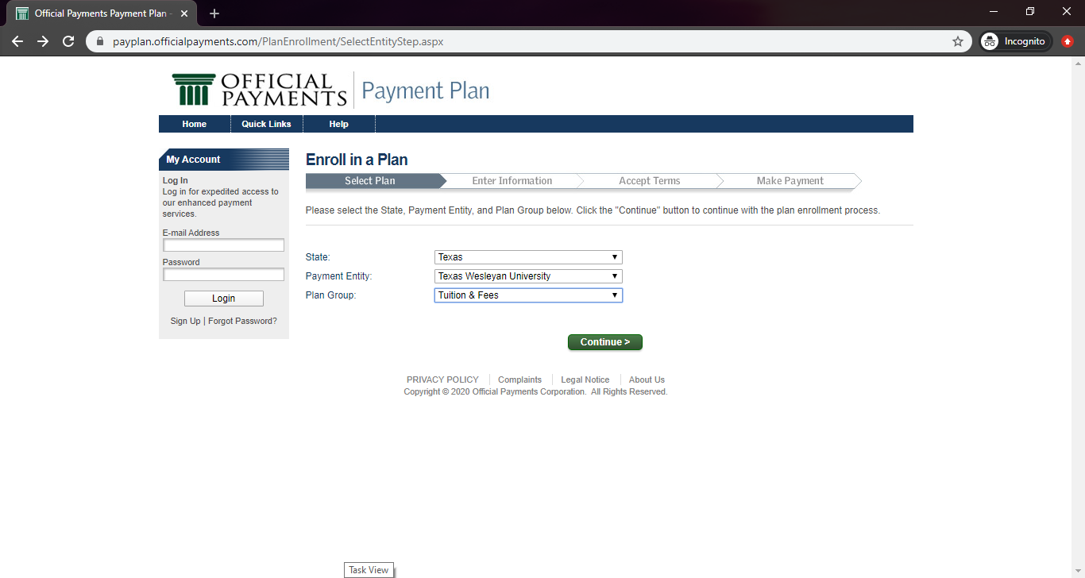
Select the following

Slide 9
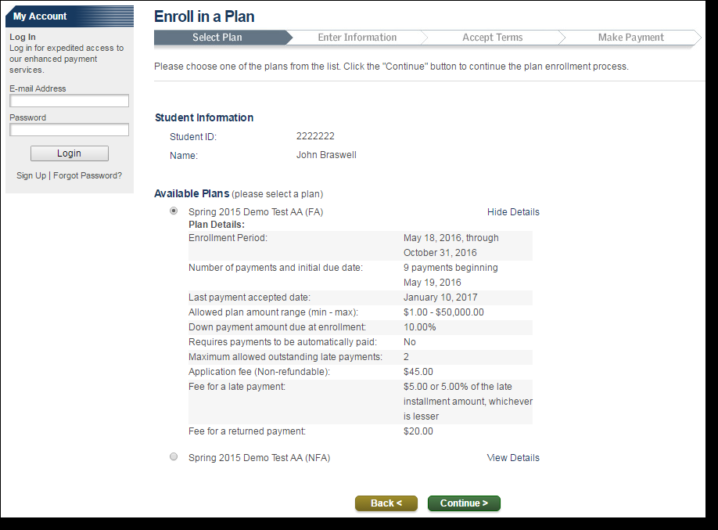
Select a plan and review plan details

Slide 10
Fill out with your information and agree to the Electronic Disclosure and Online Services Agreement

Slide 11
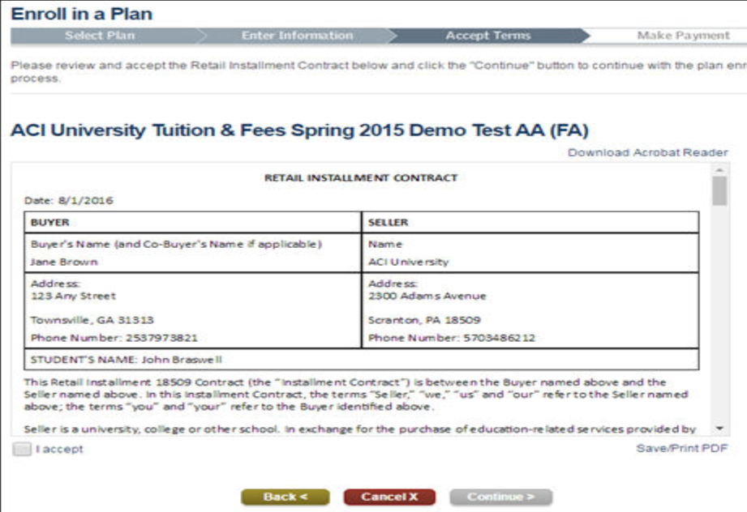
Accept terms and save for your records

Slide 12
Add a payment method to your wallet
You can change the scheduled dates if needed
Continue to Make Payment

Slide 13
Fill out Payment and Payer information

Slide 14
Double check that all of your information is correct, then hit Submit

