Slide 1
HOW TO MAKE A PAYMENT
Cashier’s Office

Slide 2
Go to www.txwes.edu
STEP 2: Click on Ramlink

Slide 3
Log-in using login credentials

Slide 4
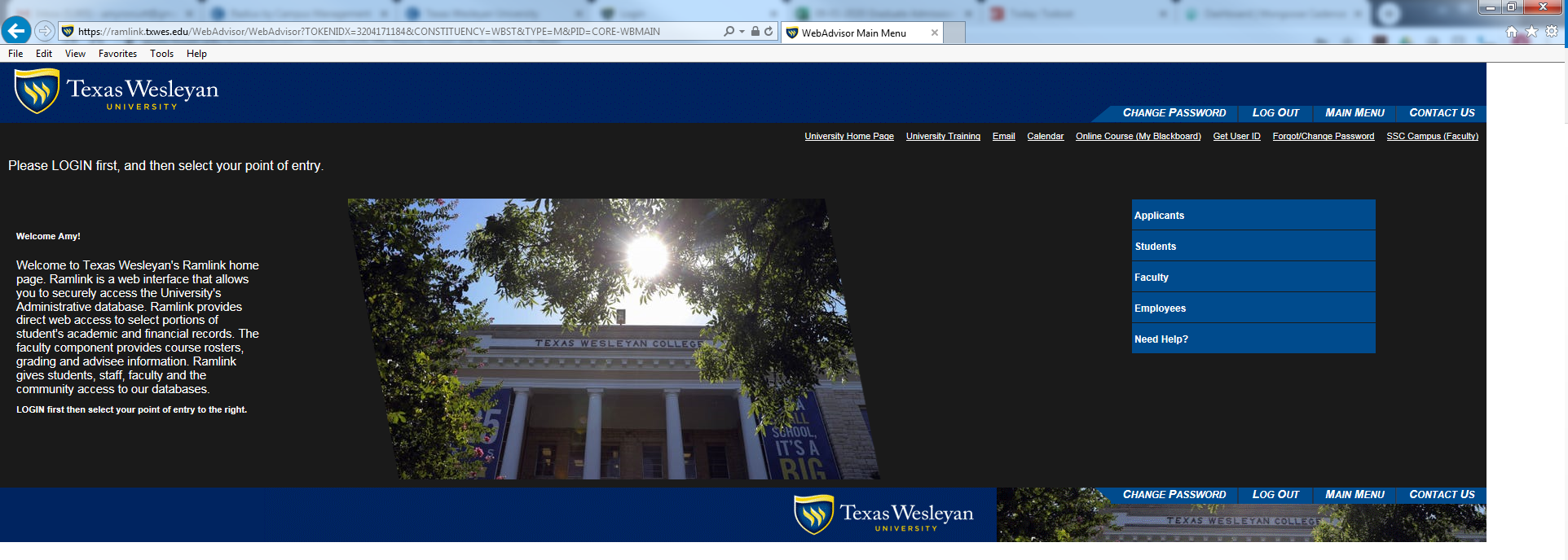
Click on the Student’s Tab

Slide 5
Click on “Make A Student Account Payment”

Slide 6
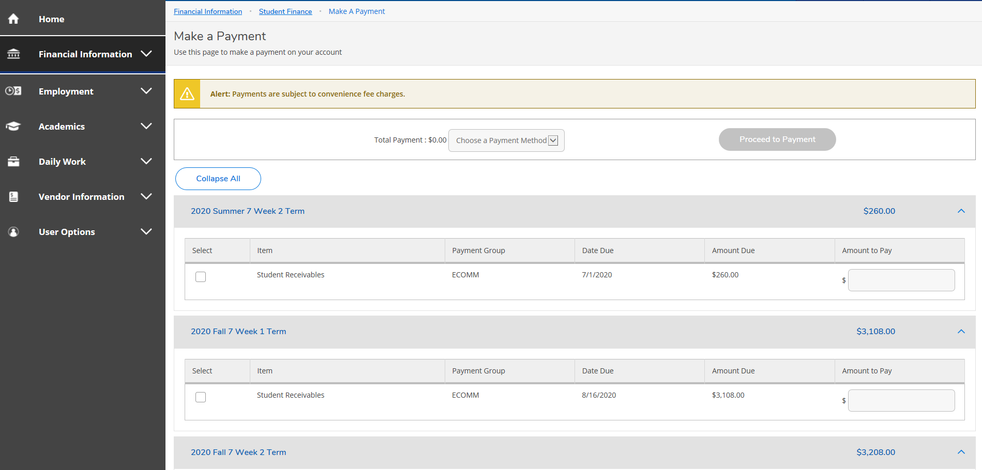
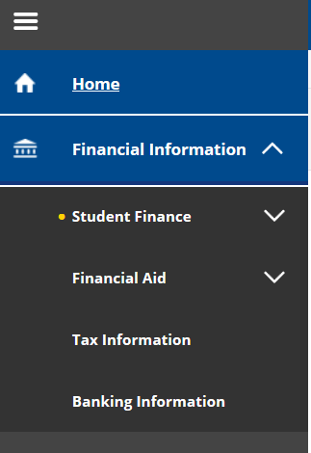
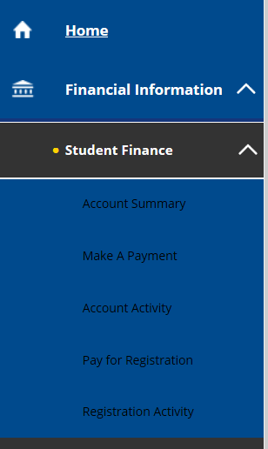
If already in the self-service center, Click on Financial Information
Click on Student Finance
Click “Make a Payment”

Slide 7
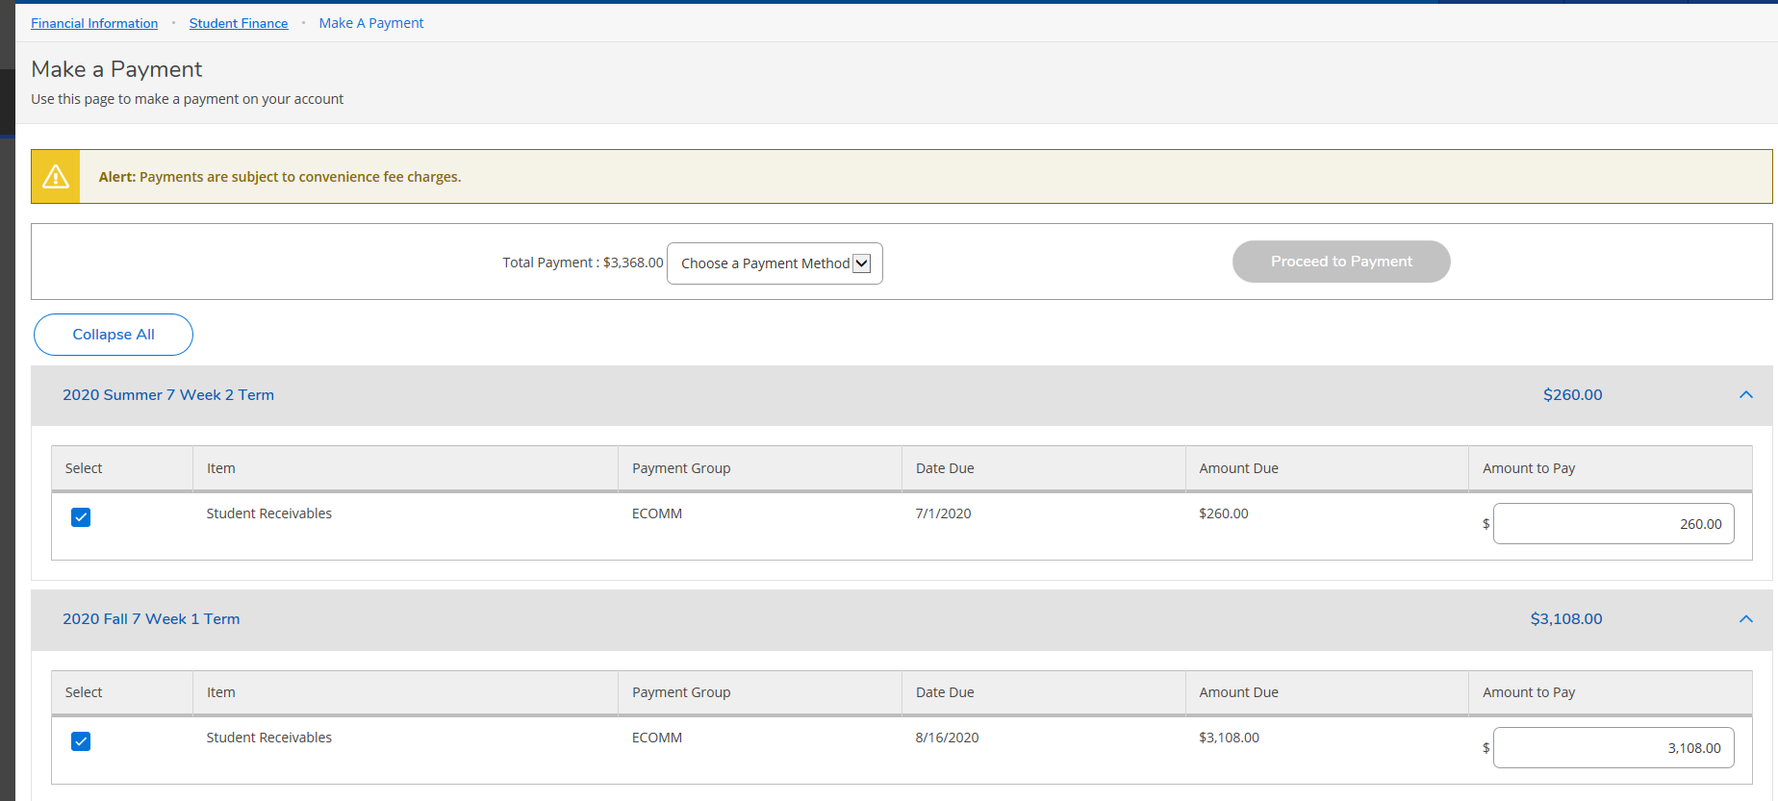
Select a payment method
Select the box and enter the amount for each term you want to pay

Slide 8
Select payment method and proceed to payment
Review payment information and select Pay Now

Slide 9
Enter banking information and click pay now

