Slide 1
UNDERSTANDING YOUR BILL
Statements, Payment Due Dates and Mini-Terms
Cashier’s Office

Slide 2
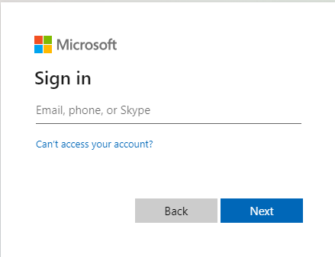
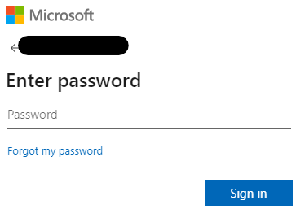
Go to https://txwes.edu/ramlink and login
Your TXWES email

Slide 3
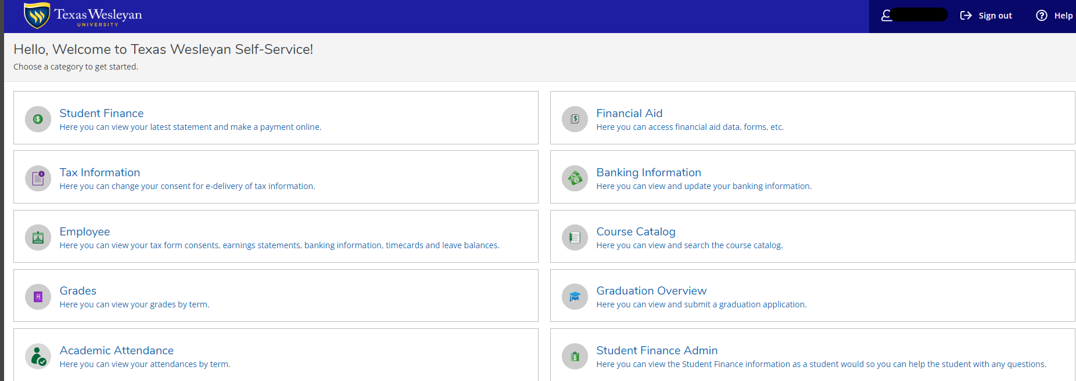

Checking Your Balance & Viewing Your Account Statement
Click on “Student Finance”

Slide 4
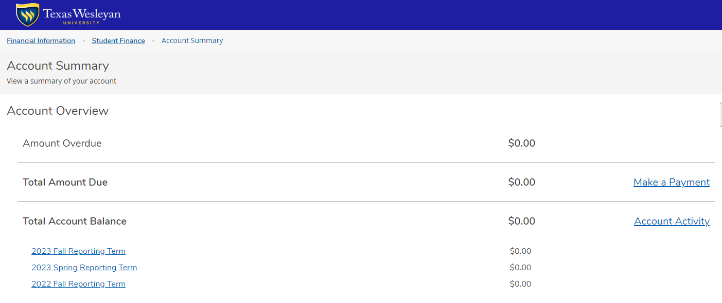
Click on “Account Activity”

Slide 5
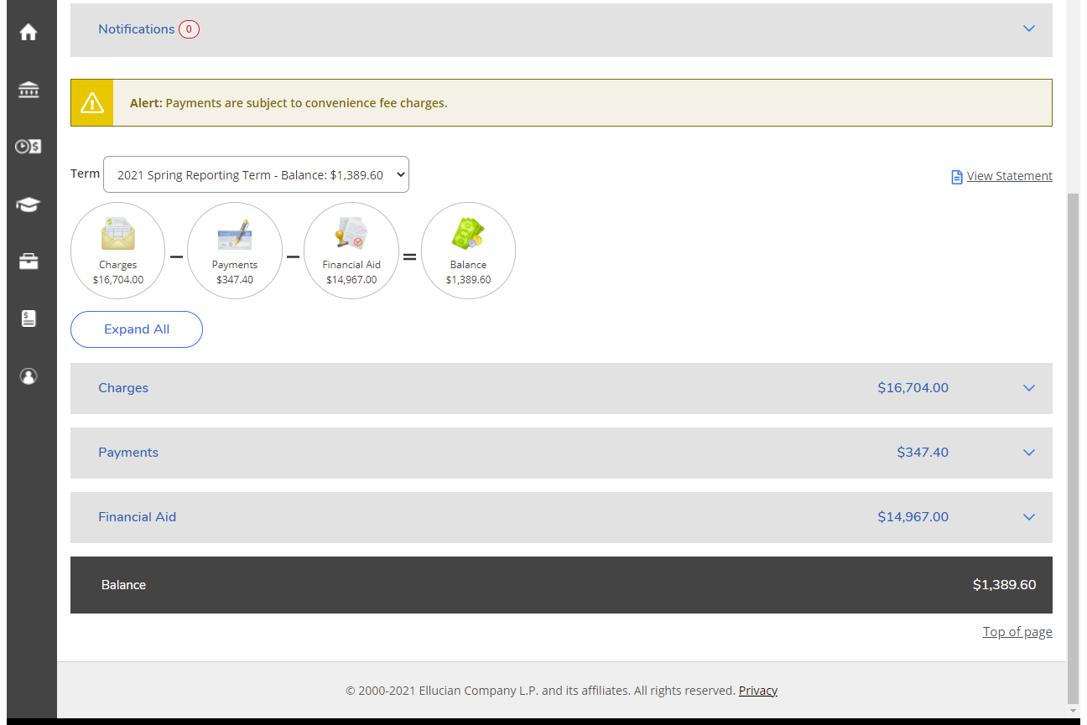
This is a breakdown of your charges,
financial aid, and payments by semester
Each tab expands for an in-depth explanation

Slide 6
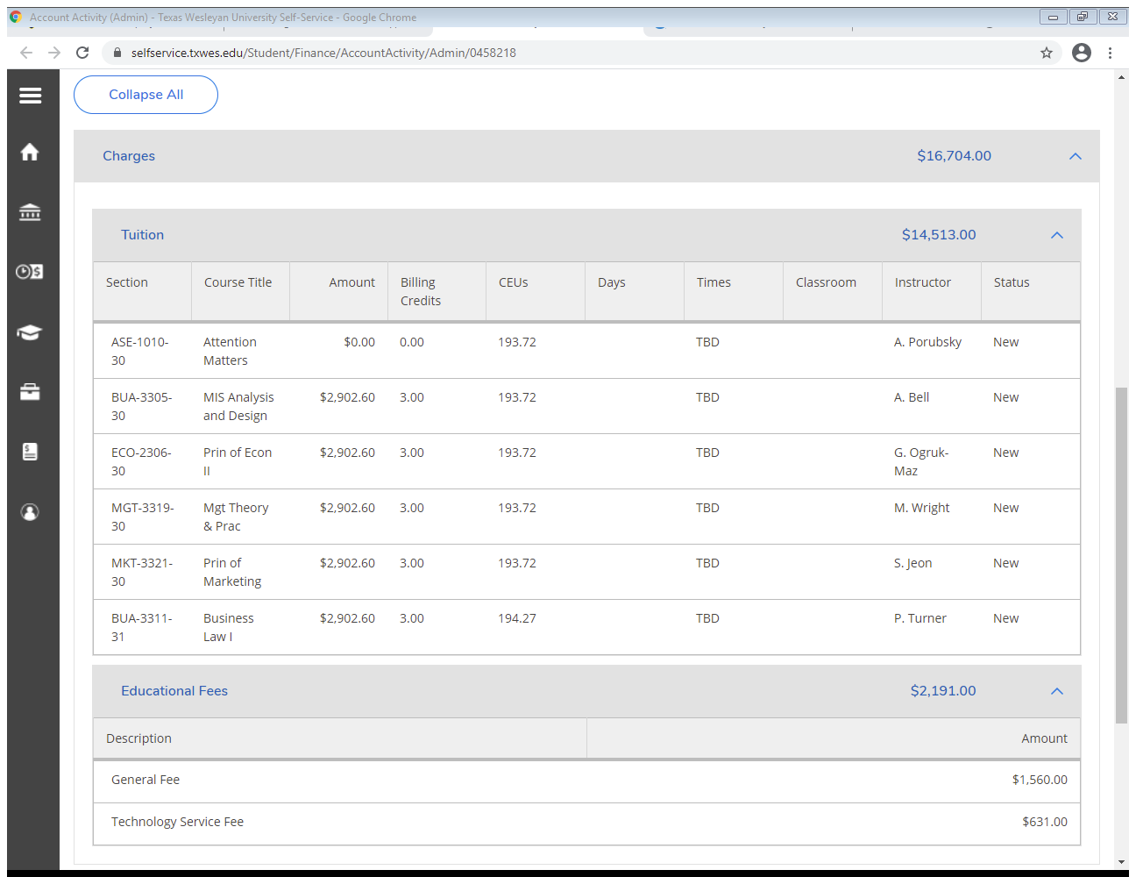
Charges = tuition & fees
In addition to the general and technology fees, you may have course fees, graduation fees, bookstore charges, late registration fees or insurance charges

Slide 7
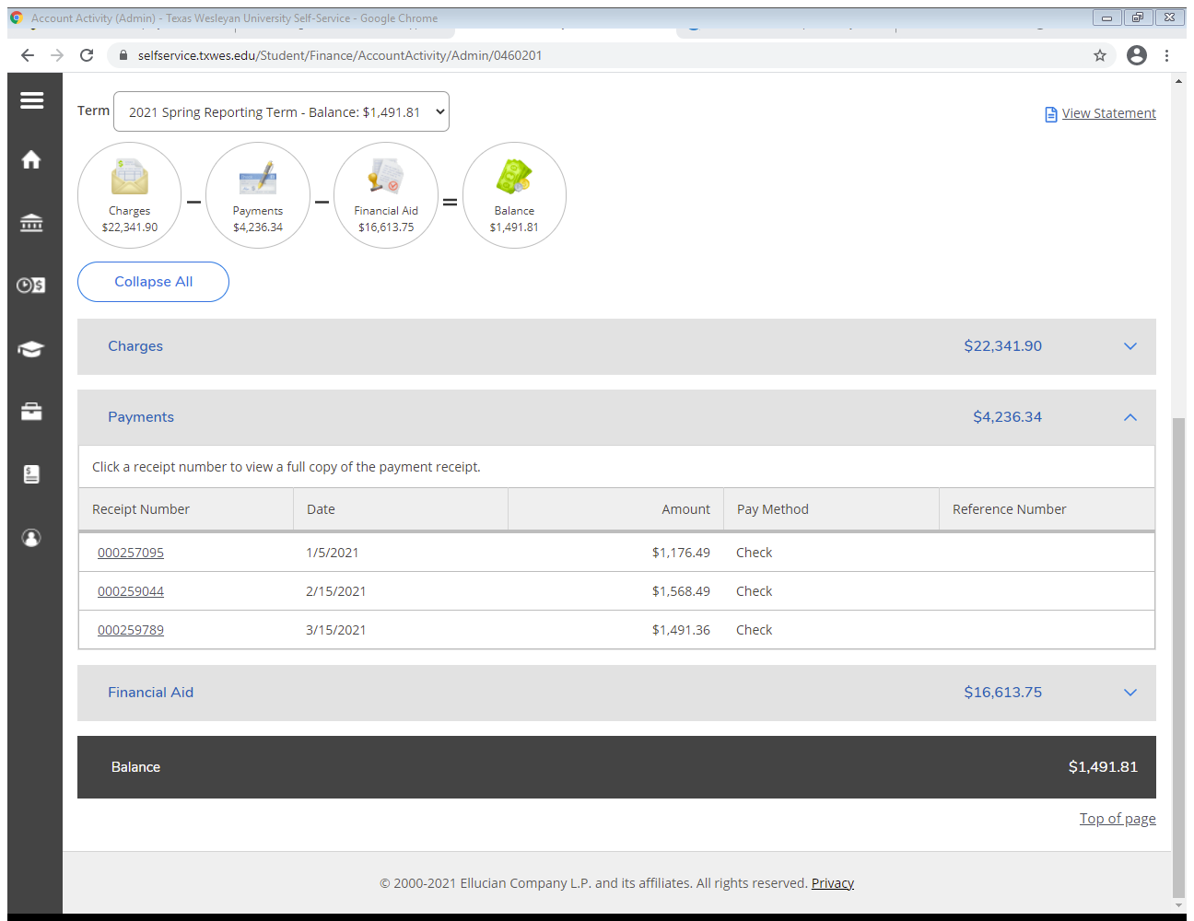
If you’re in a payment plan, each monthly payment will post here
The “Payments” tab gives you a breakdown of all payments made on your account

Slide 8
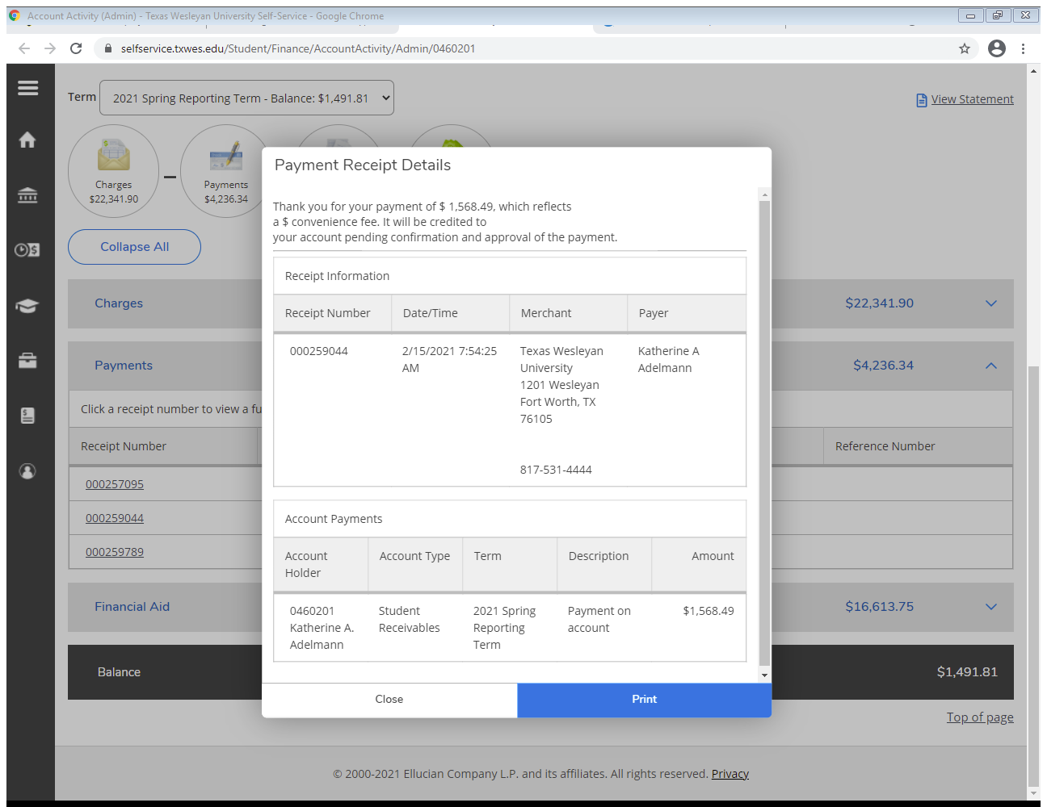
Each receipt expands to give you a full detail of your payment

Slide 9
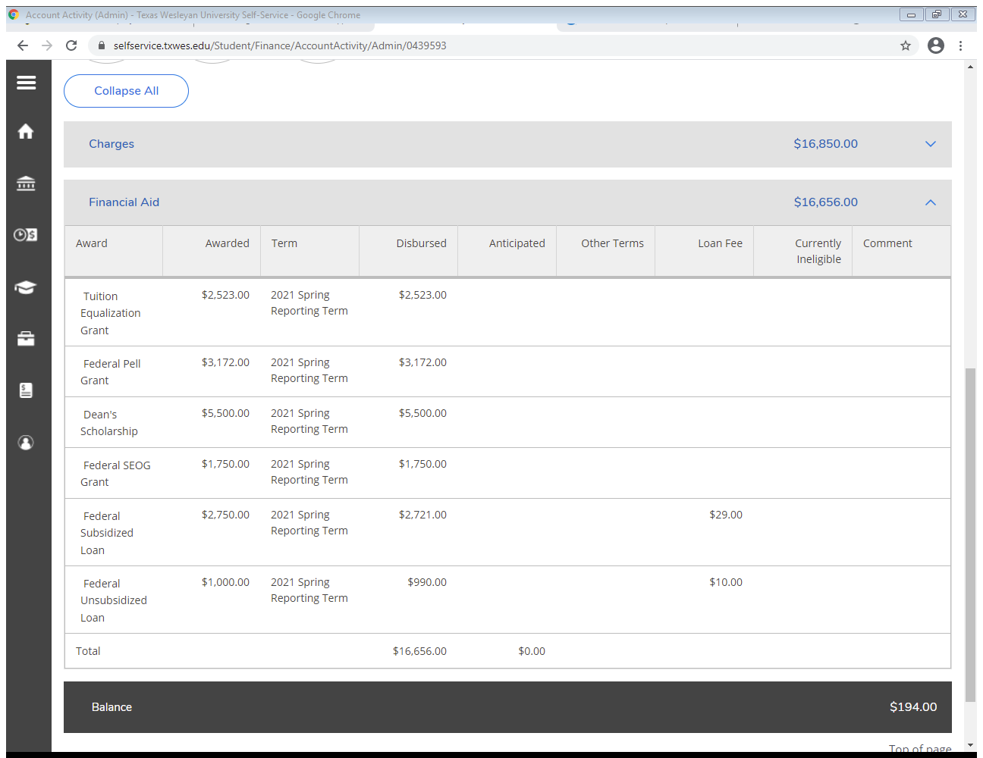
The “Financial Aid” tab breaks down all of your different types of aid and their amounts

Slide 10
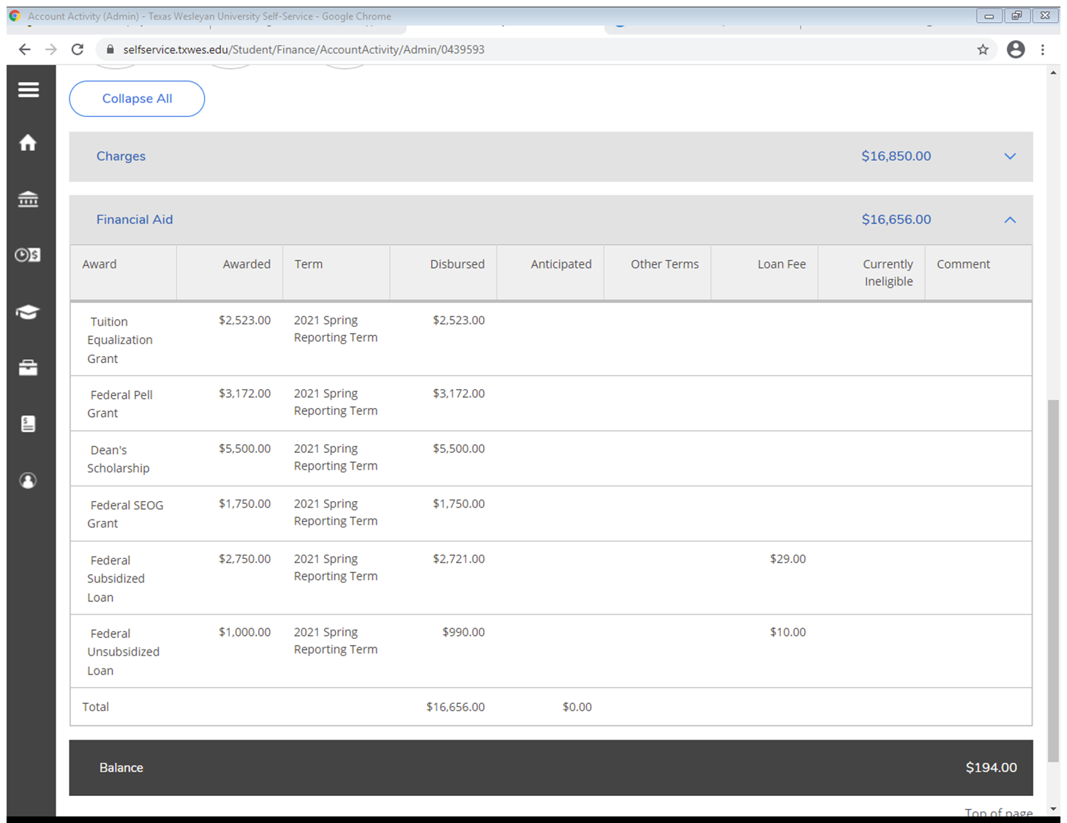
Anticipated: Expected for your account
If there is an issue with a piece of your aid, you can find more information here.
Disbursed: Funded to your account

Slide 11


Need every category expanded?
Need to print your statement?
Click “View Statement”

Slide 12
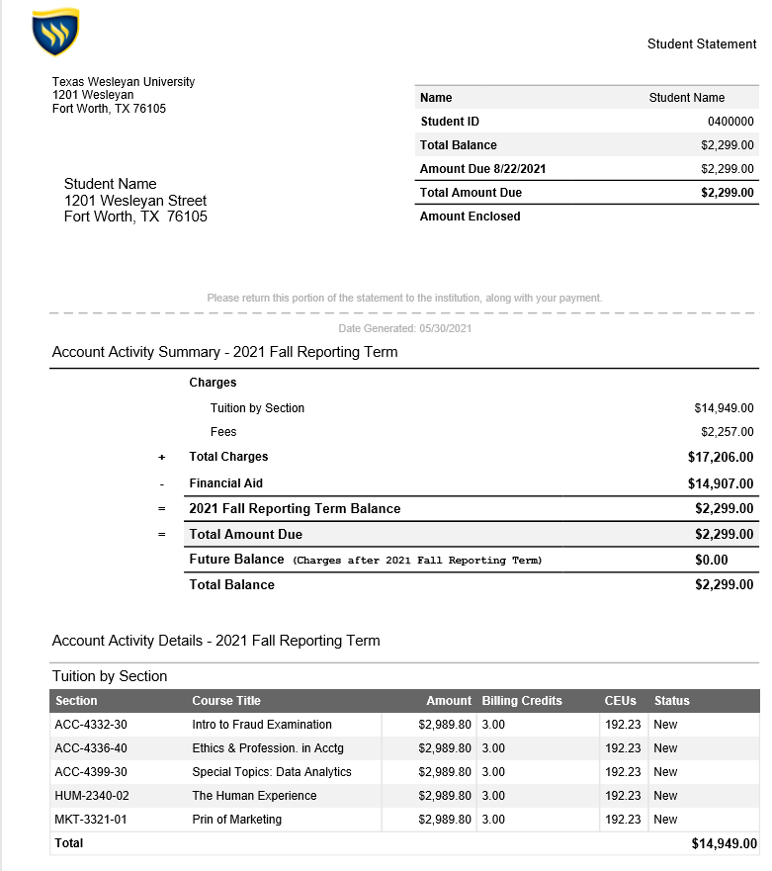
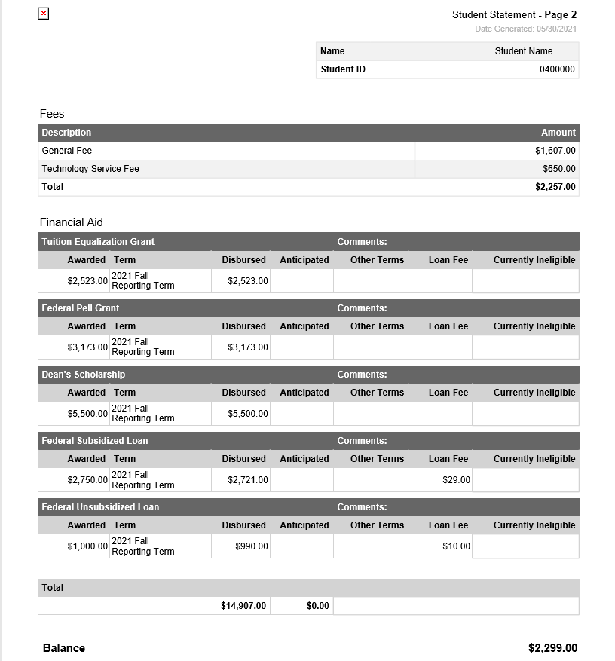
Balance due is a cumulative of all unpaid
charges.
Balance due is a cumulative of all unpaid charges.

Slide 13

Need to pay off your balance over the semester?
All classes and terms are now eligible for the official payment plan!

Slide 14
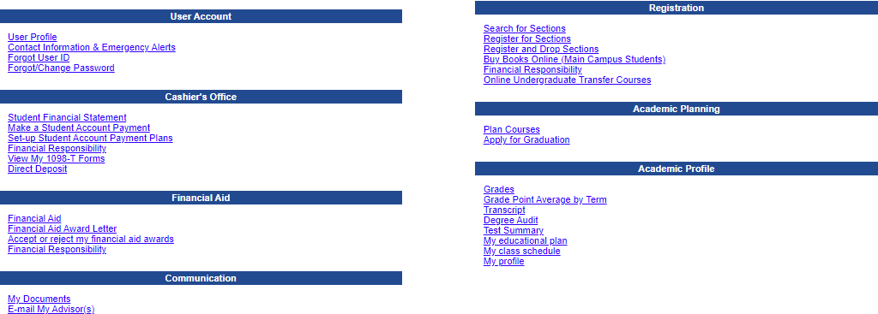
IF you are taking a class in the mini-term, the balance for that class is due the day before the class starts
Not sure if you’re in a mini-term class or when class starts?
Check out your class schedule! The start date is listed for every class.

